Slide 1
Data Science Basics in R:
Day 3: Exploratory data analysis

Slide 2
Goals for today
Define descriptive statistics & exploratory data analysis
Create your first data visualization in R
Identify options for visualization in R, including ggplot2
Great creative and have fun exploring datasets

Slide 3
bit.ly/r_basics_day3

Slide 4
Descriptive statistics

Slide 5
Descriptive statistics
Descriptive statistics summarize data, and typically describe three types of things:
center (e.g., mean, median)
spread (e.g., standard deviation, interquartile range)
counts & rates (e.g., summary tables)
In a typical data analysis workflow, we often explore these first! It’s helpful to better understand your data, and to identify potential surprises or anomalies.

Slide 6
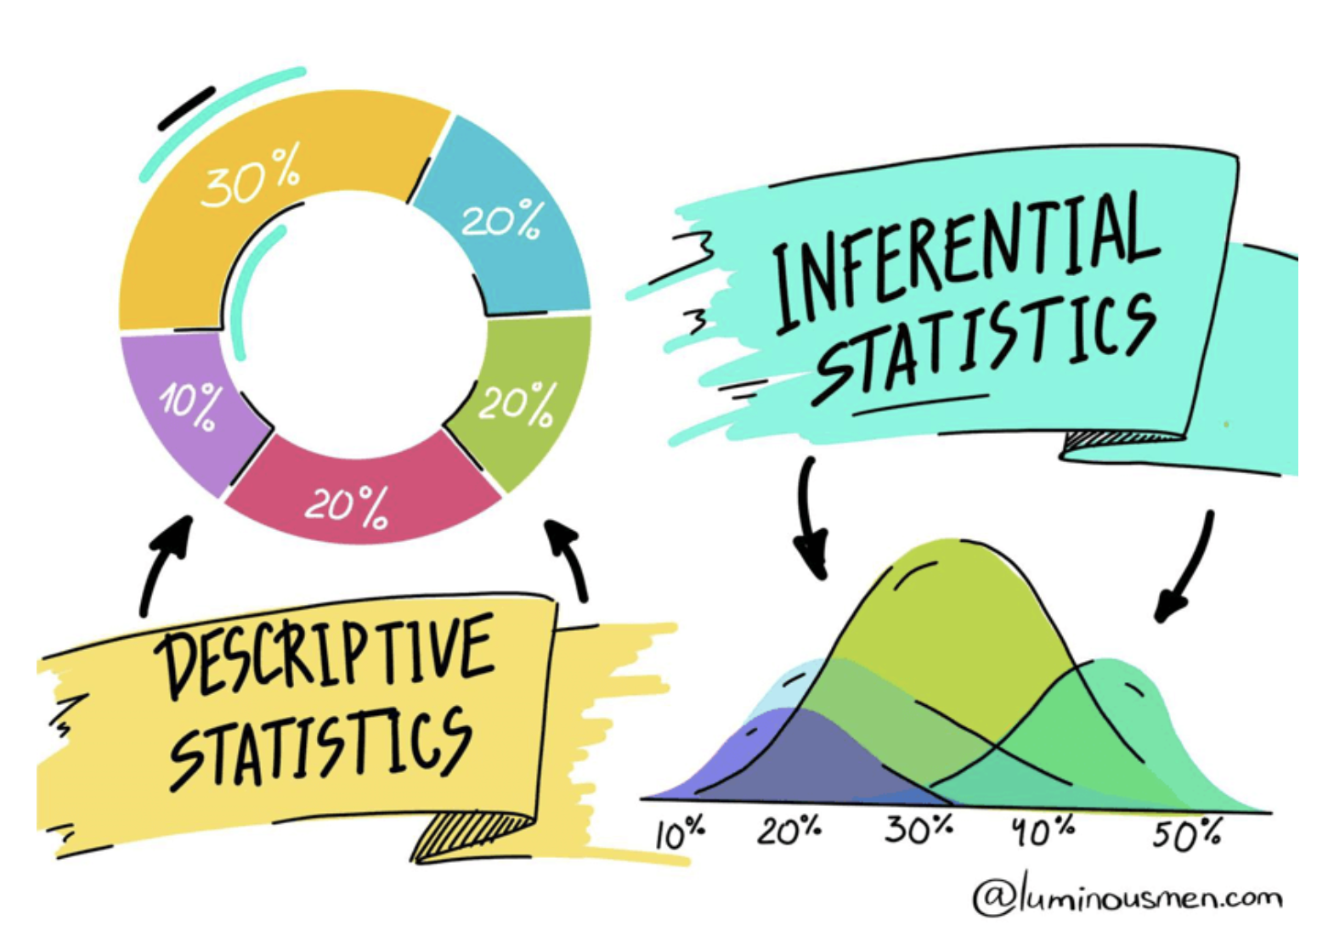
Graphic by luminousmen.com
https://luminousmen.com/post/descriptive-and-inferential-statistics

Slide 7
Choosing a data visualization

Slide 8
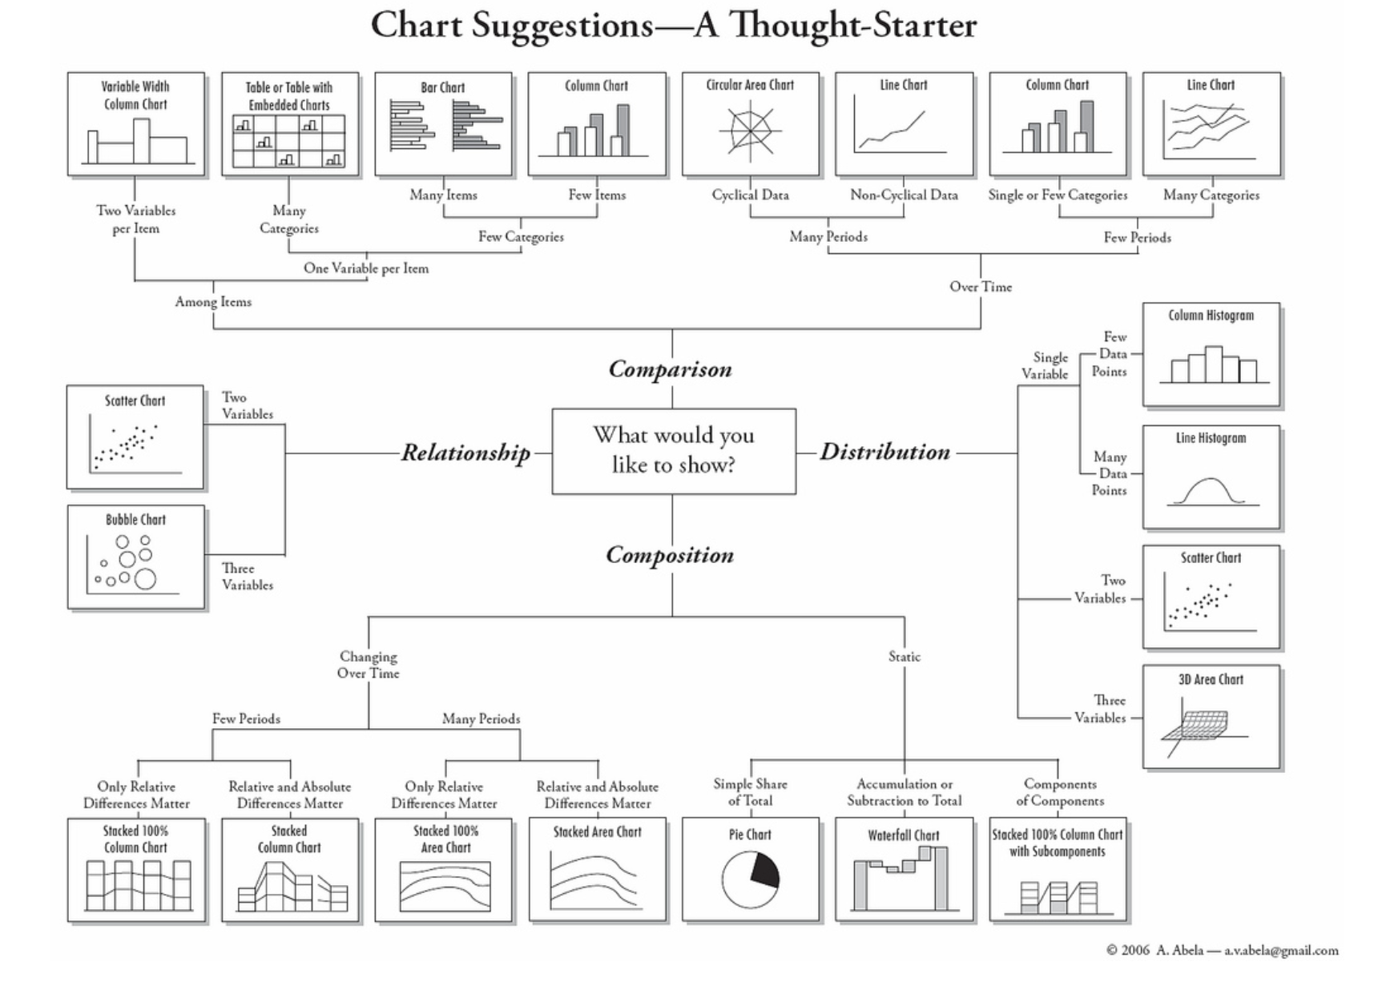
What are you trying to learn?
Graphic by Andrew Abela
https://extremepresentation.typepad.com/blog/2006/09/choosing_a_good.html

Slide 9
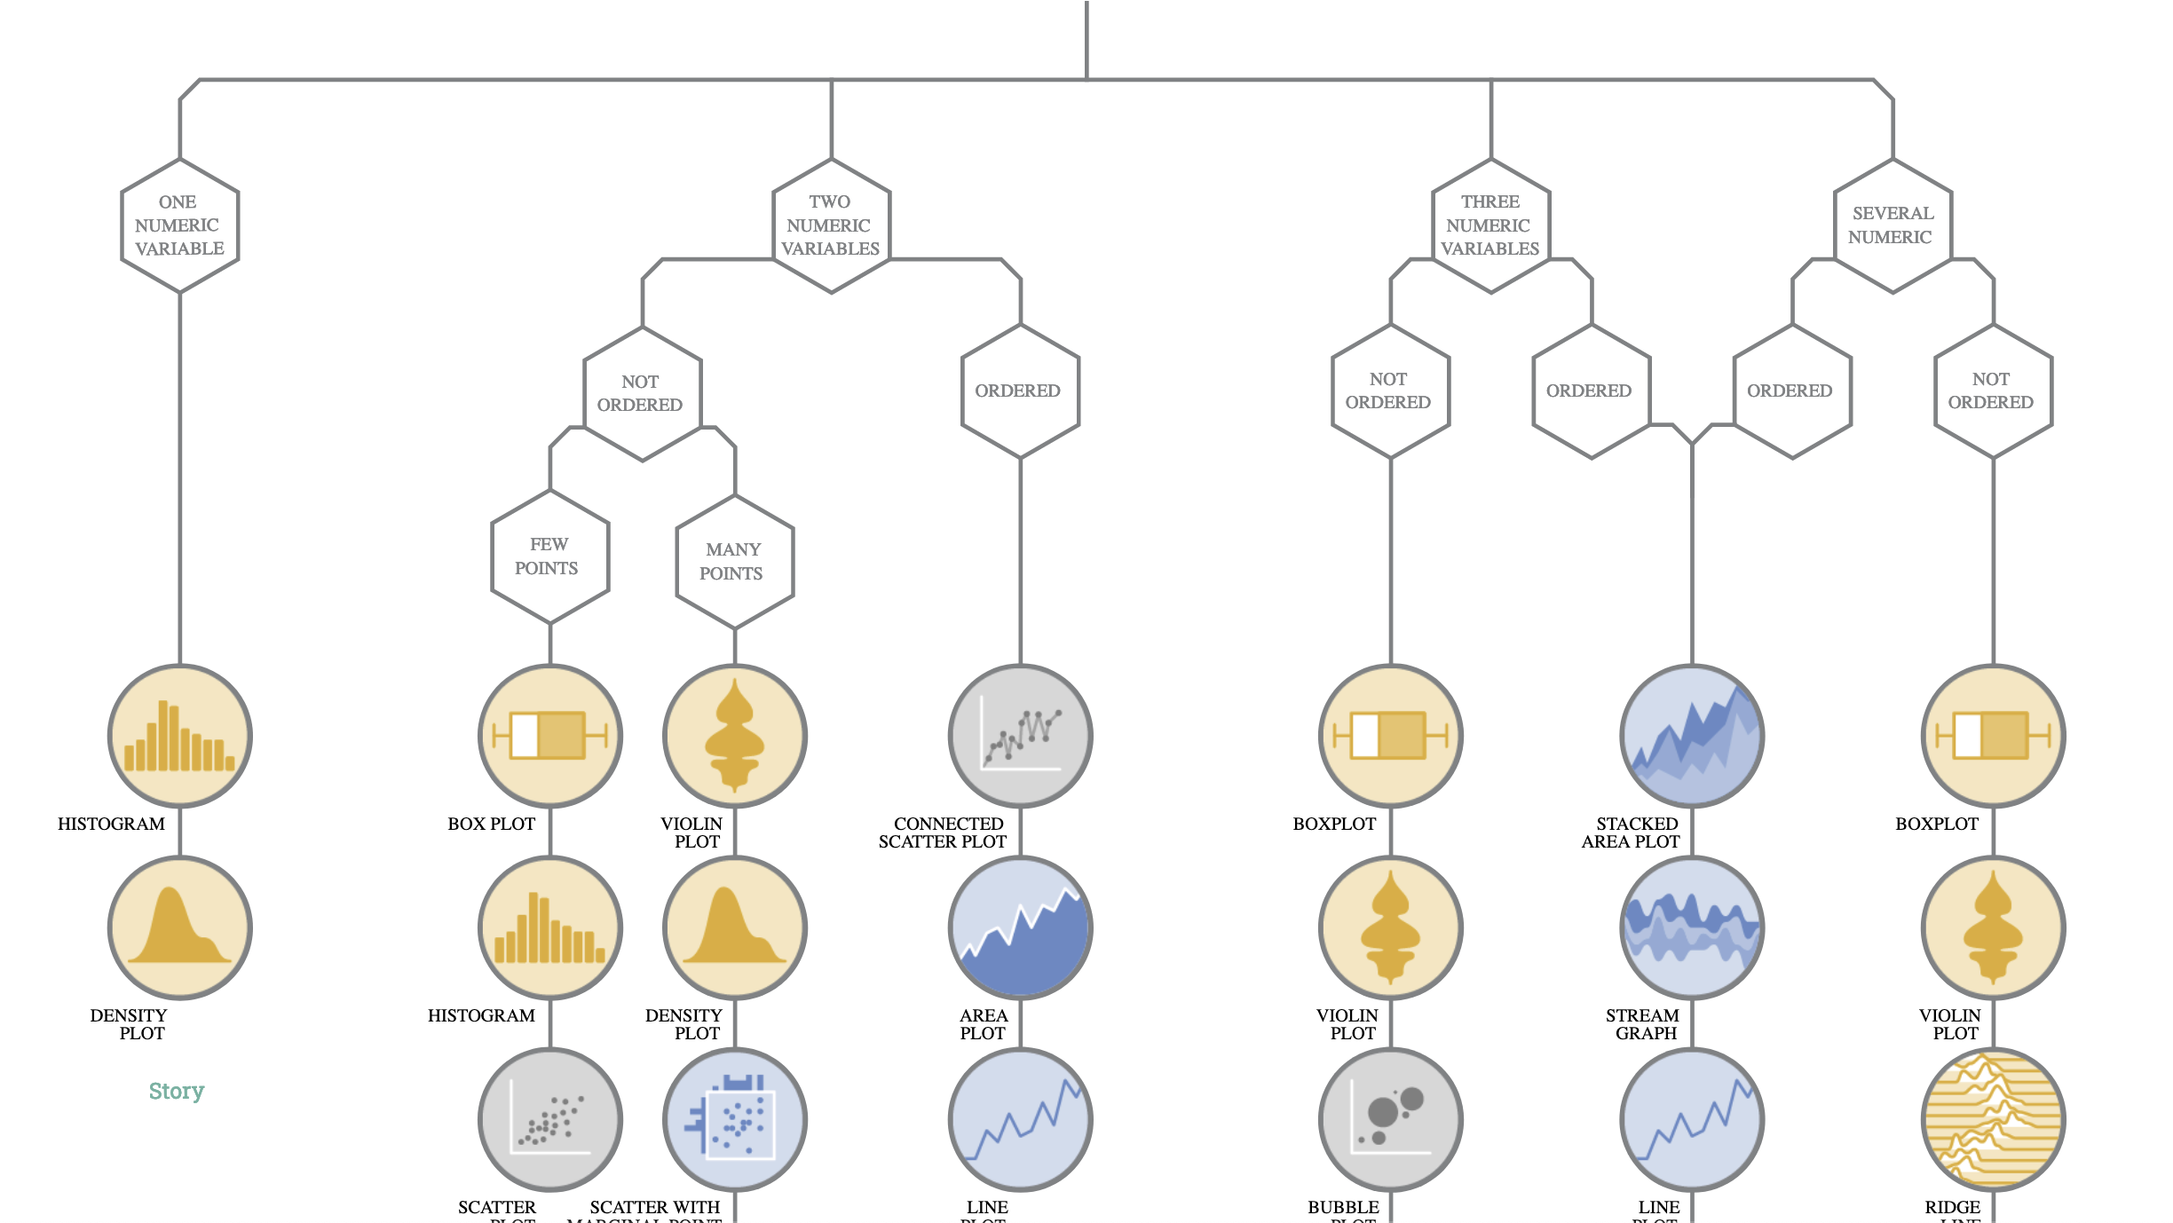
What are you trying to learn?
Graphic by Data to Viz
https://www.data-to-viz.com/

Slide 10
Plots in base R
(see code in github for live demo)

Slide 11
For context:
Notes about plots
The datasets used to generate these plots were chosen by students and participants of the R workshop in 2023. They reflect the diverse interests of the cohort!

Slide 12
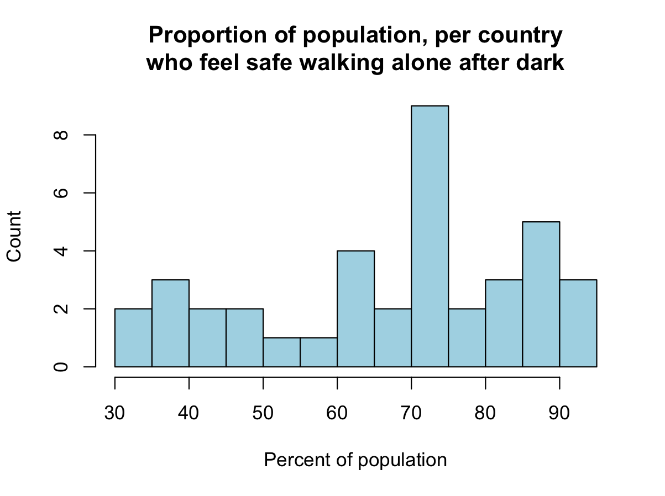
Histograms: Base R

Slide 13
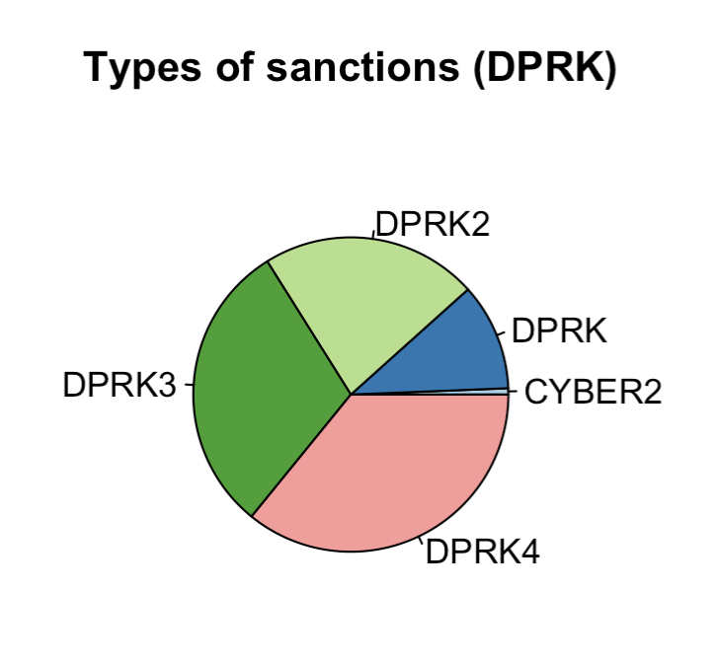
Pie chart: Base R

Slide 14
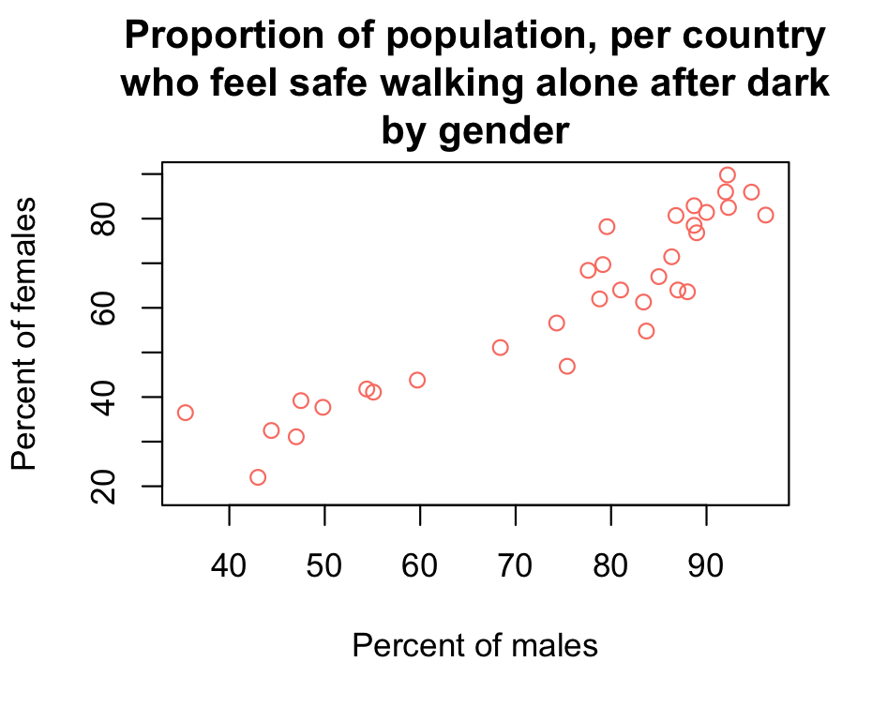
Scatterplot: Base R

Slide 15
Fun with ggplot2

Slide 16
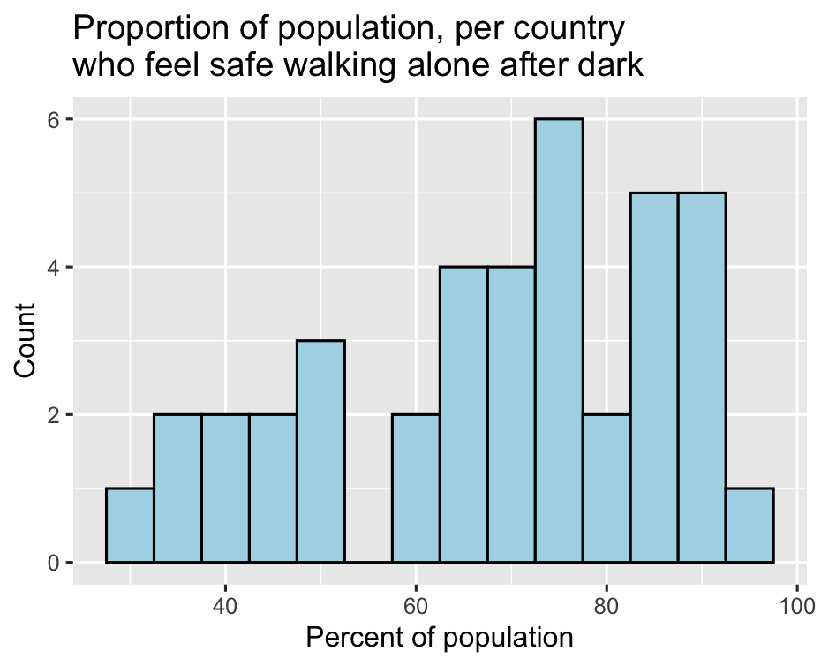
Histogram: ggplot2

Slide 17
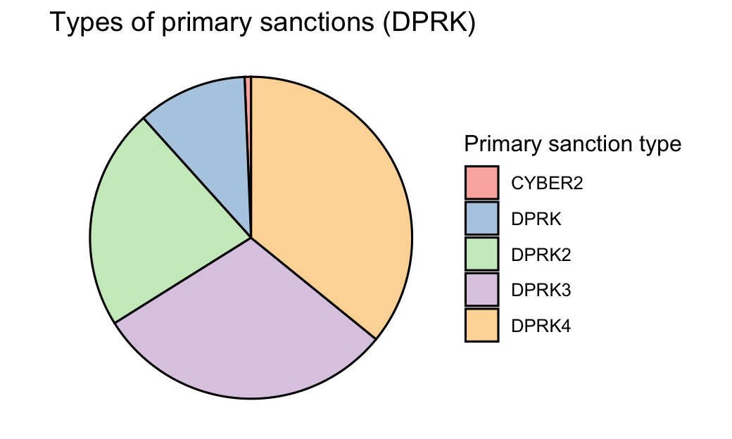
Pie chart: ggplot2

Slide 18
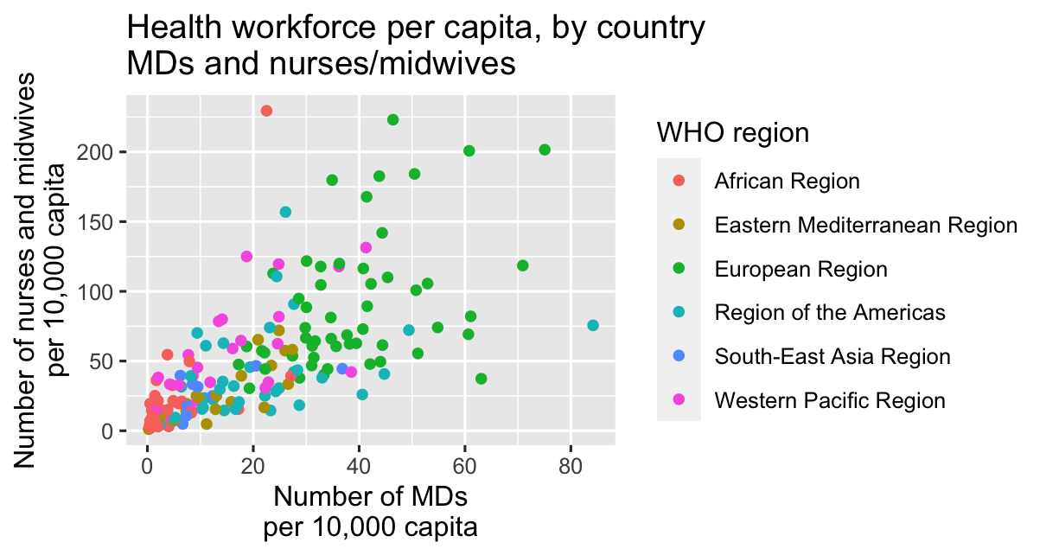
Scatterplot: ggplot2

Slide 19
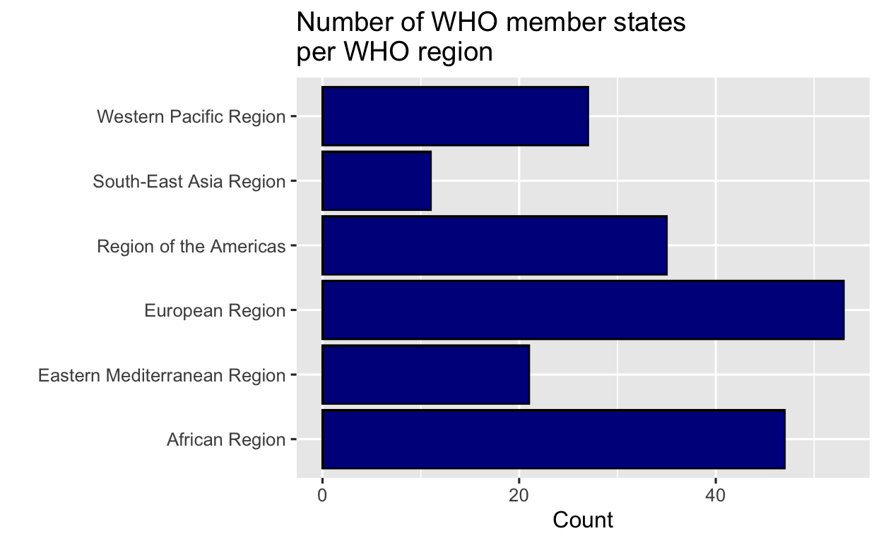
Barplot: ggplot2

Slide 20
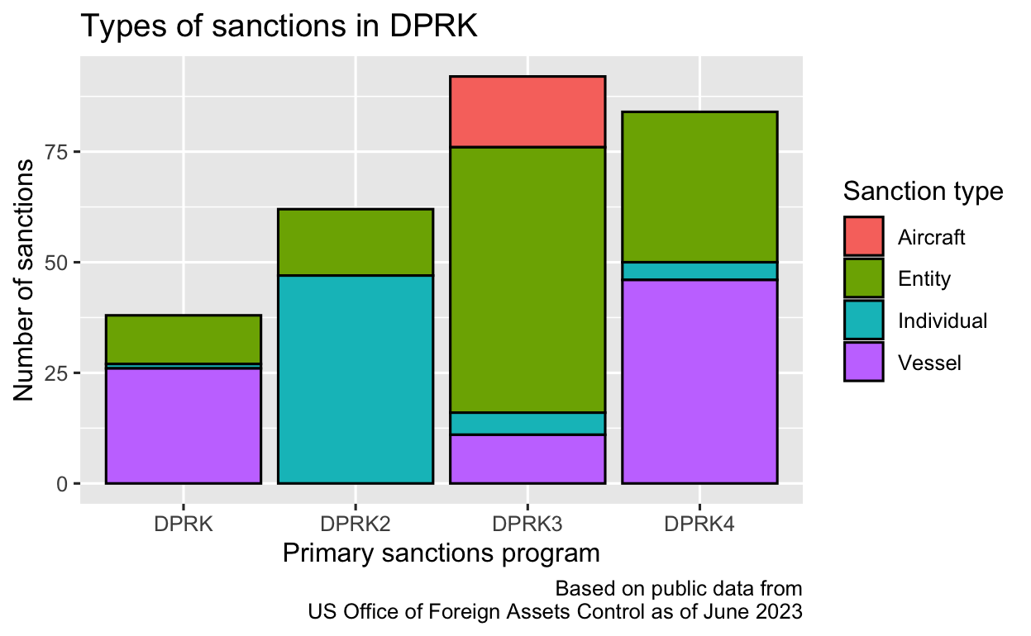
Stacked barplot: ggplot2

Slide 21
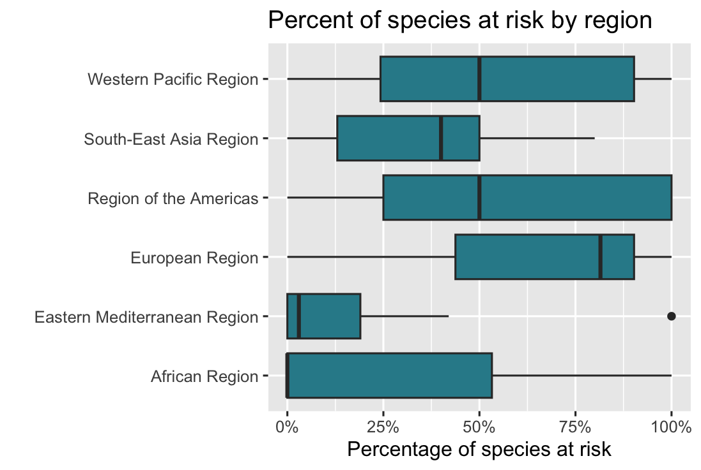
Boxplot: ggplot2

Slide 22
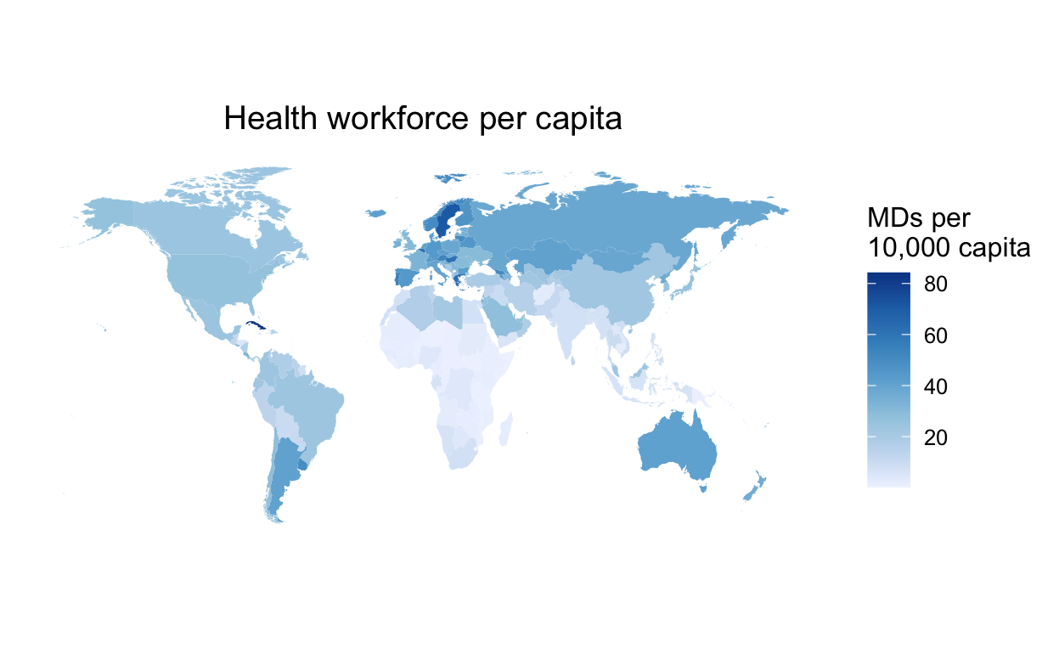
World map: ggplot2

Slide 23
Extra fun with ggplot2

Slide 24
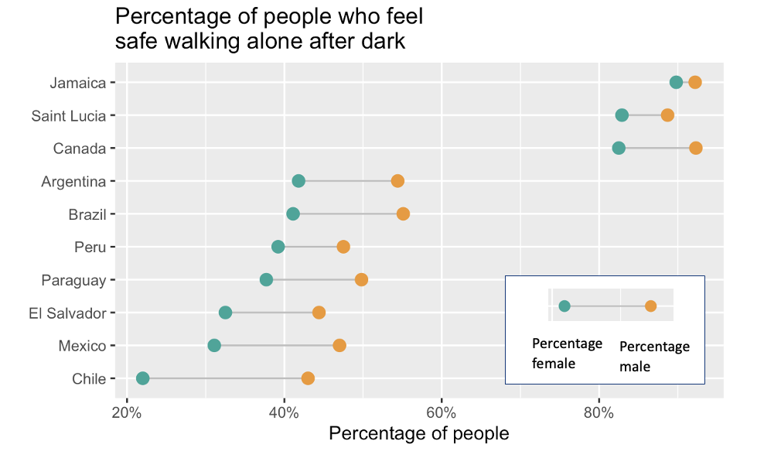
Cleveland dot plot: ggplot2

Slide 25
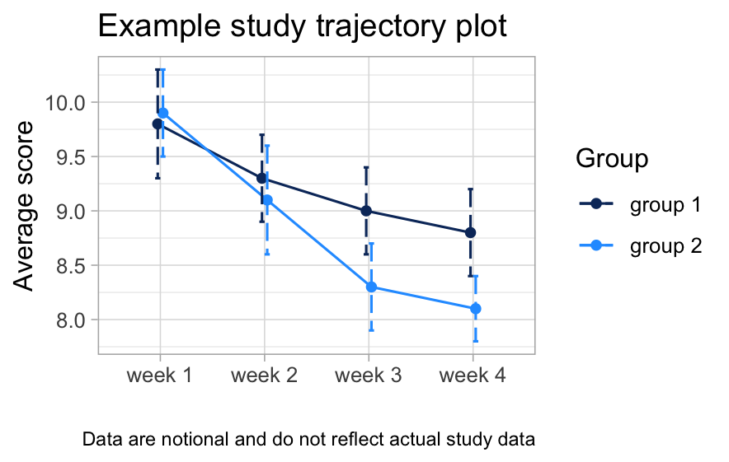
Trajectory plot (line): ggplot2

Slide 26
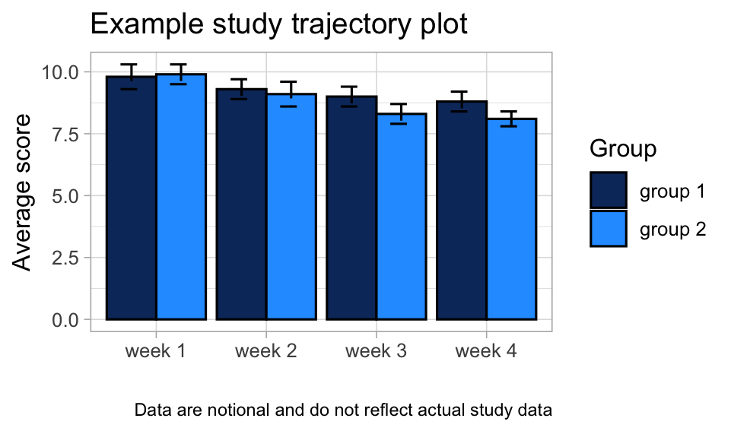
Trajectory plot (bar): ggplot2

Slide 27
Choosing colors for your plots

Slide 28
Best practices for color selection
Choose colors that align to the data you are plotting and what you are trying to communicate.
Ordinal scales: consider a color gradient
Categorical scales: use colors that you can tell apart
Consider how others will perceive your data
Colorblindless (e.g., red/green)/ visual disabilities
Research on color perception and ability to distinguish between colors

Slide 29
Do you have some examples of color palettes that we know are good?
https://colorbrewer2.org/ has great options, toggle to see “colorblind safe”, “print friendly” and “photocopy safe” options, select between data types
If you’re working for a company or organization, do they have existing style guides you can adapt?
https://www.abbygolddesign.com/projects/bill-melinda-gates-foundation
https://www.unaids.org/en/brandbuilder/colour

Slide 30
Where can I go for more color inspiration?
These sites were NOT necessarily designed for data visualization and may not work well for your purpose, but especially if your plot only uses one color, you can use them for inspiration!
https://colorhunt.co
https://coolors.co
https://projects.susielu.com/viz-palette
https://mycolor.space/
https://www.learnui.design/tools/data-color-picker.html

Slide 31
Exporting plots from R Studio

Slide 32
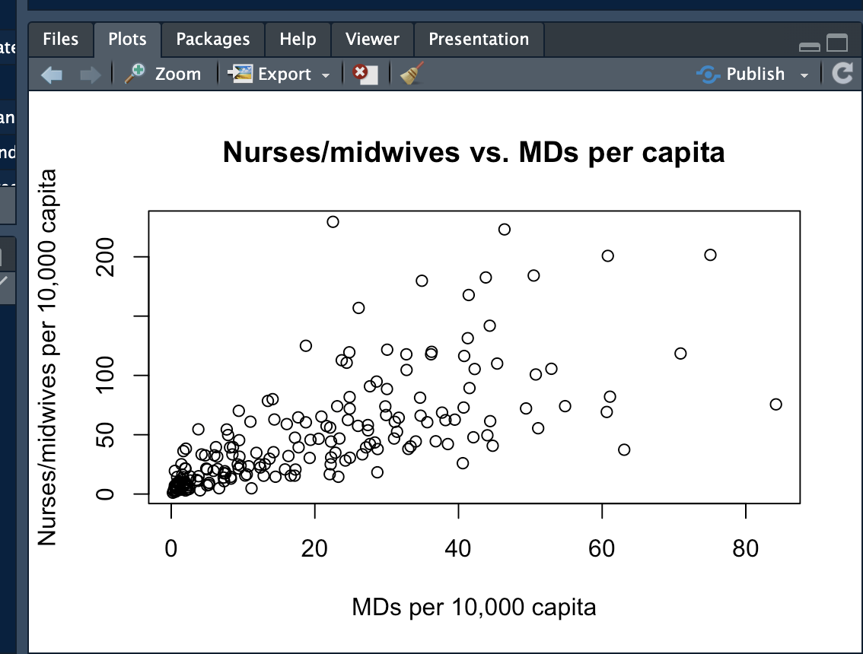
Exporting plots from RStudio

Slide 33
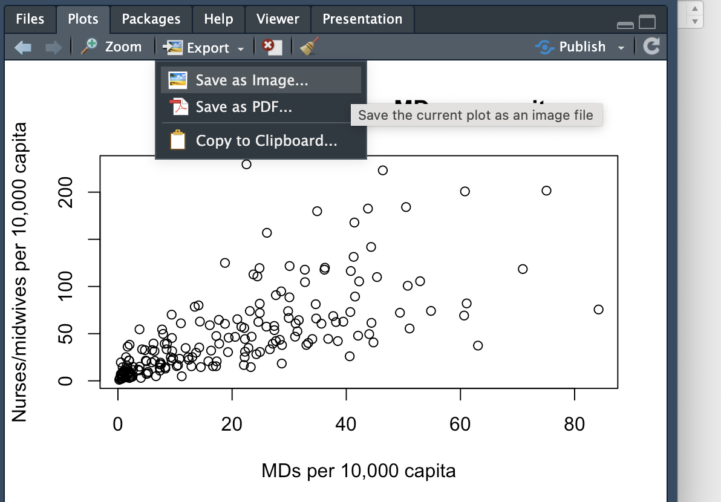
Exporting plots from RStudio

Slide 34
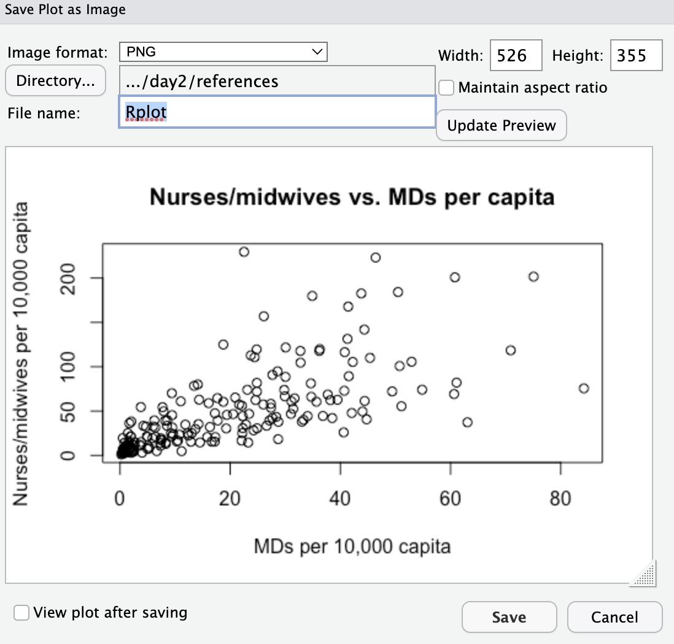
Exporting plots from RStudio
Name your file

Slide 35
Exporting plots from RStudio
Specify where you want to save the file

Slide 36
Exporting plots from RStudio
Adjust dimensions

